Slide 1
임베디드 시스템
EX7_4조_20092518_김민종

Slide 2
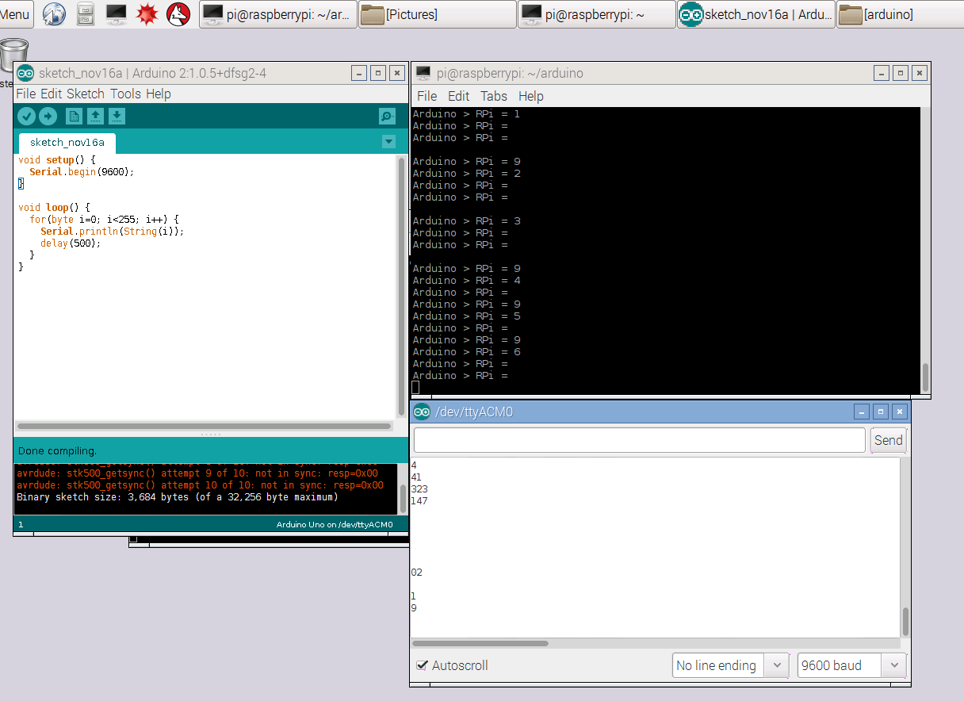
Problem 1. Implement UART direct communication using voltage devider concept.

Slide 3
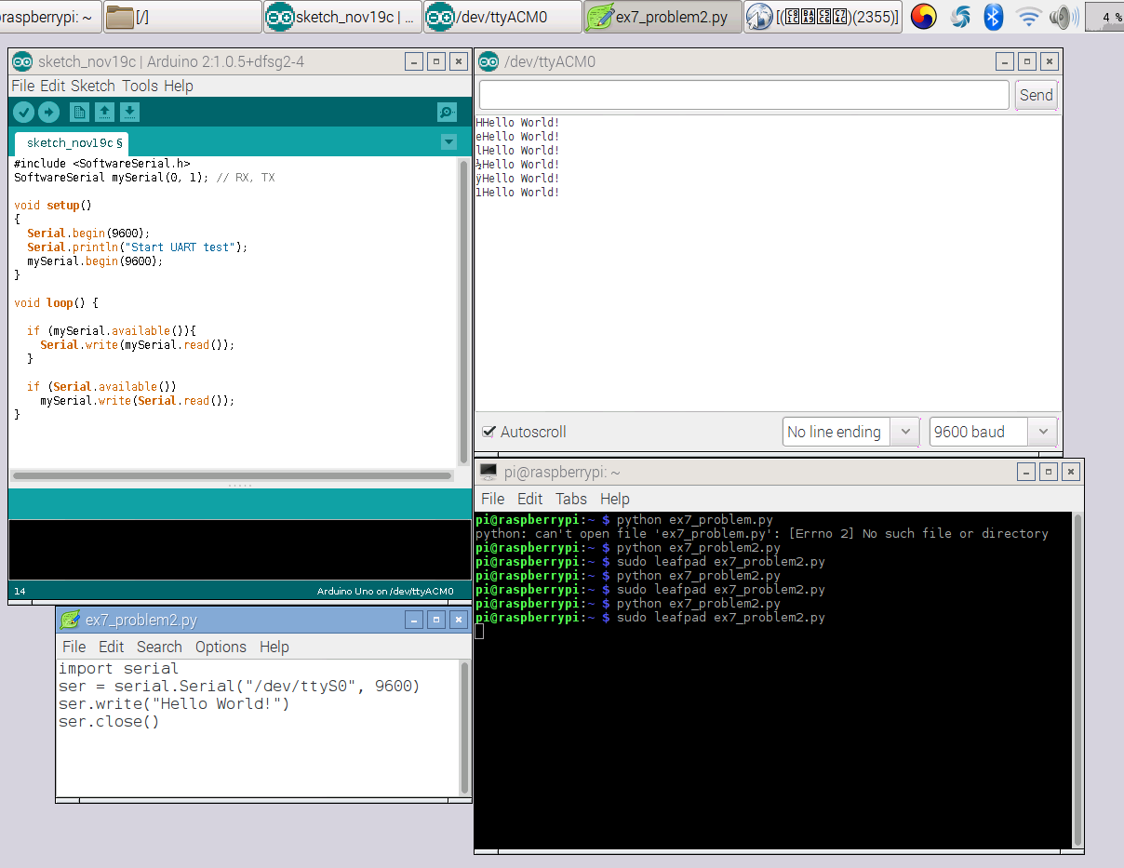
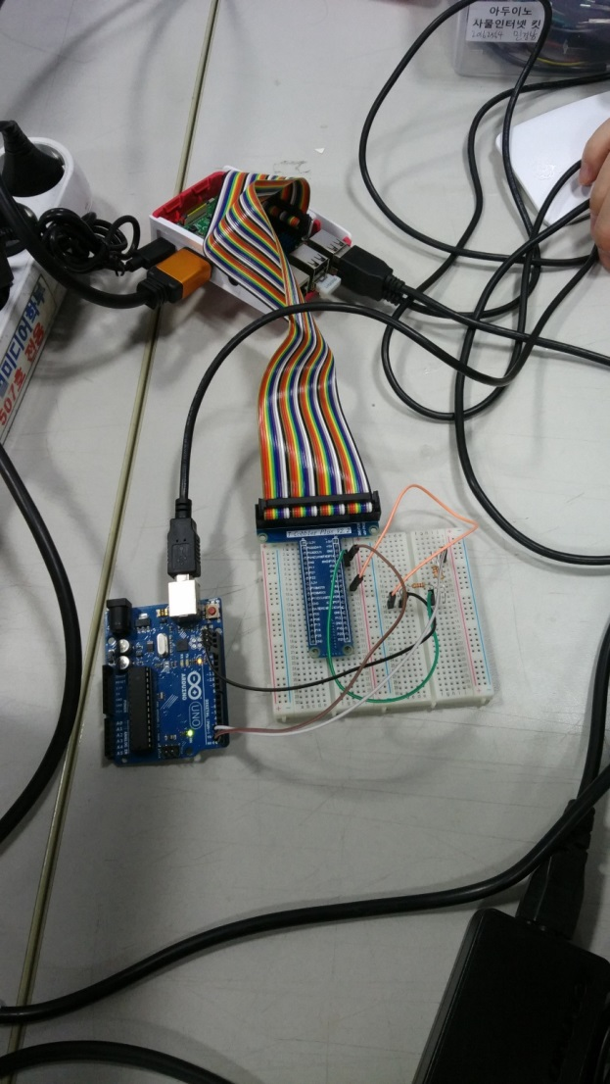
Problem 2. Implement UART USB communication using python code.

Slide 4
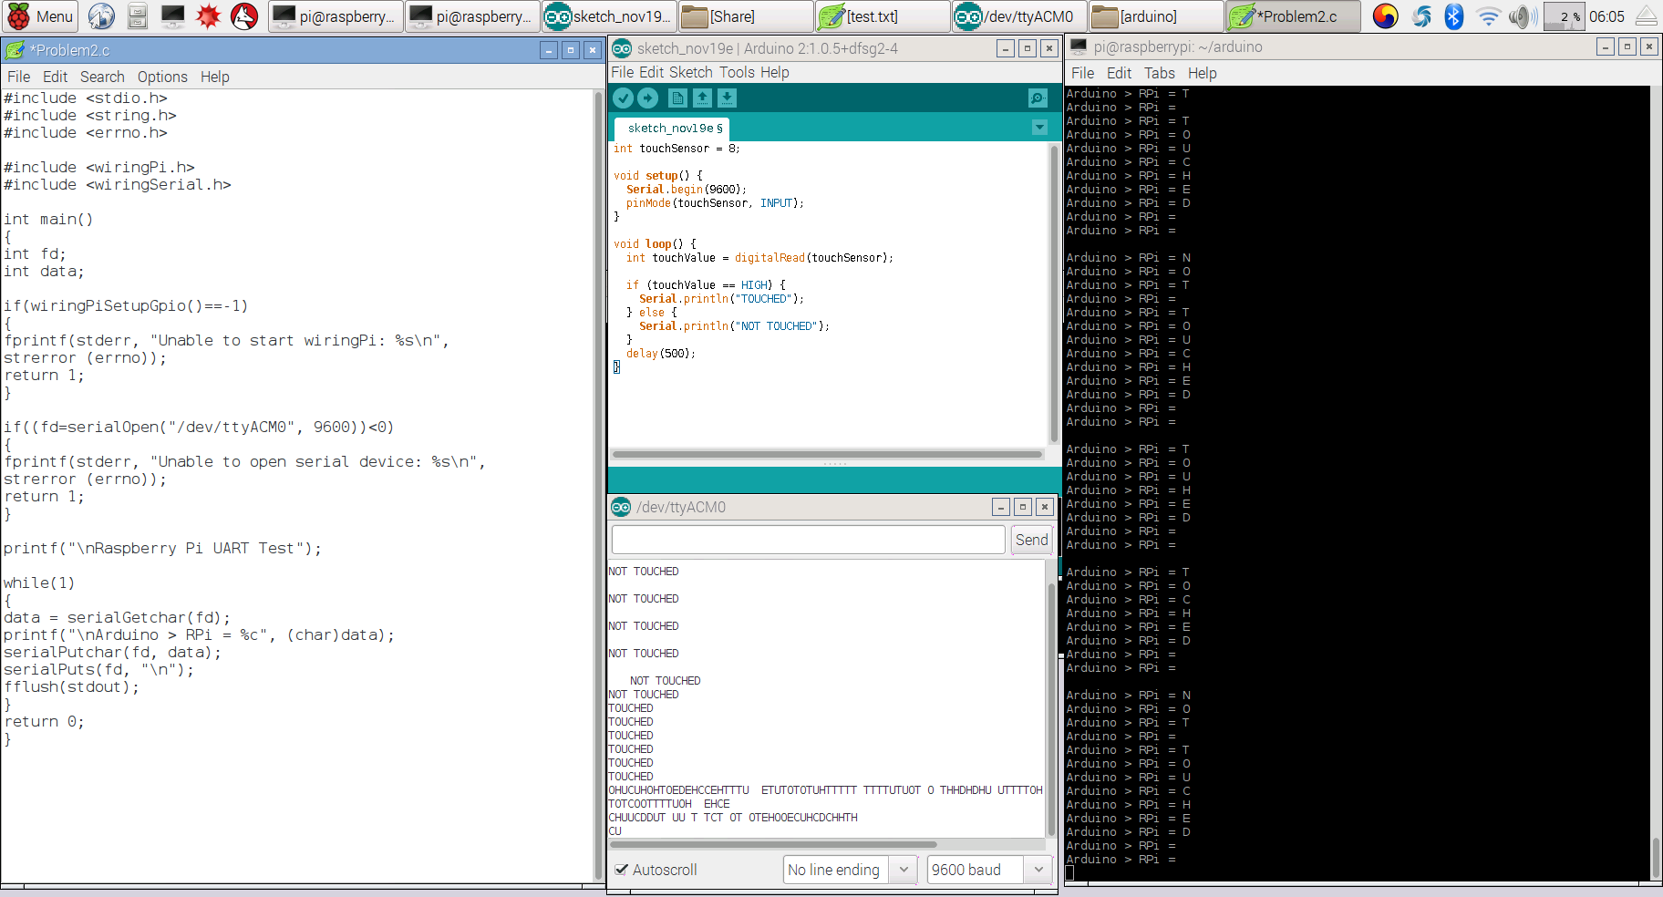
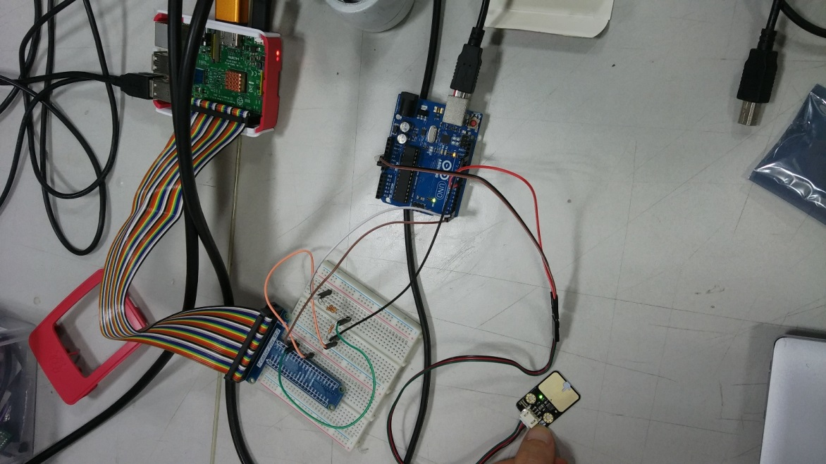
Problem 3. After receiving Arduino sensing data, raspberry must print out the data on screen like fig 5-16.
*터치센서 활용

